Slide 1
Schools availability correlation with socio-demographics in Sao Paulo city
By Guilherme Kleine

Slide 2
Introduction
São Paulo, Brazil is a sprawling vibrant metropolis, with great disparity of social-economic conditions and educational opportunities.
This study will try to analyze the social-economics of each of São Paulo 95 districts and correlated it with school/children ration

Slide 3


Data Aquisition
Data Set1: Government Census
Data Set2: Foursquare API
More than Socio-Demografic 200 indexes for the 1595 microregions inside Sao Paulo
Number of Elementary, High and Private Schools on a 2km radius of each distric

Slide 4
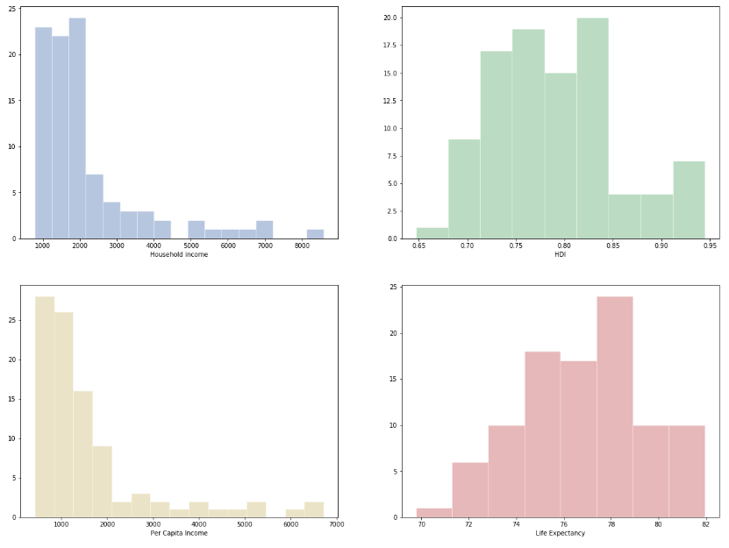
Data analysis 1
Socio-economic Indexes
There is big disparity on average income between the districts, with most districts staying at the lower end

Slide 5
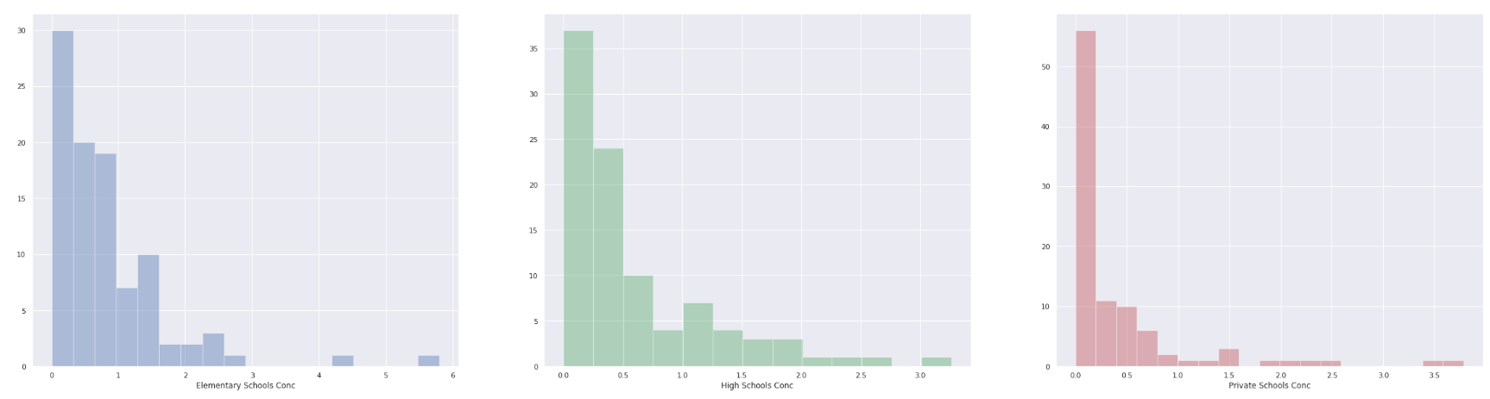
Data analysis 2
School Availability
Similary to previous indexes, there is a big variation in school avaiability with most districts bellow 1 school/1000 child

Slide 6
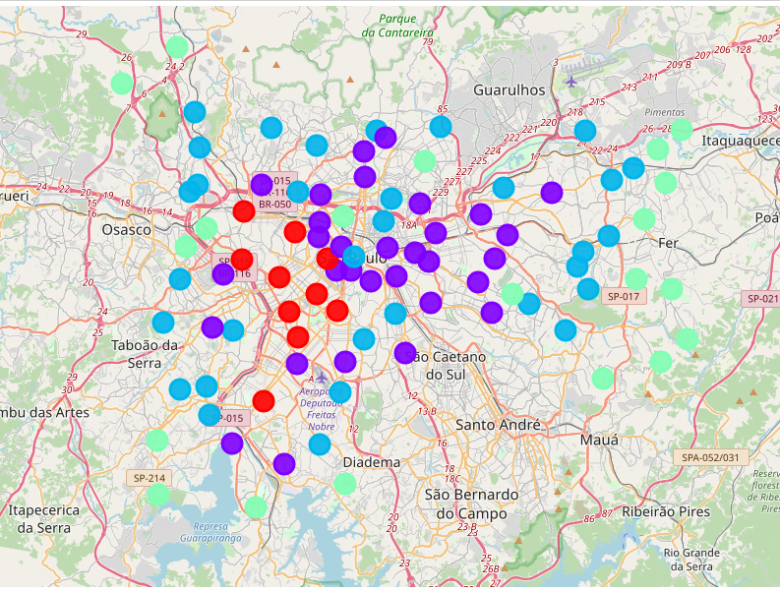
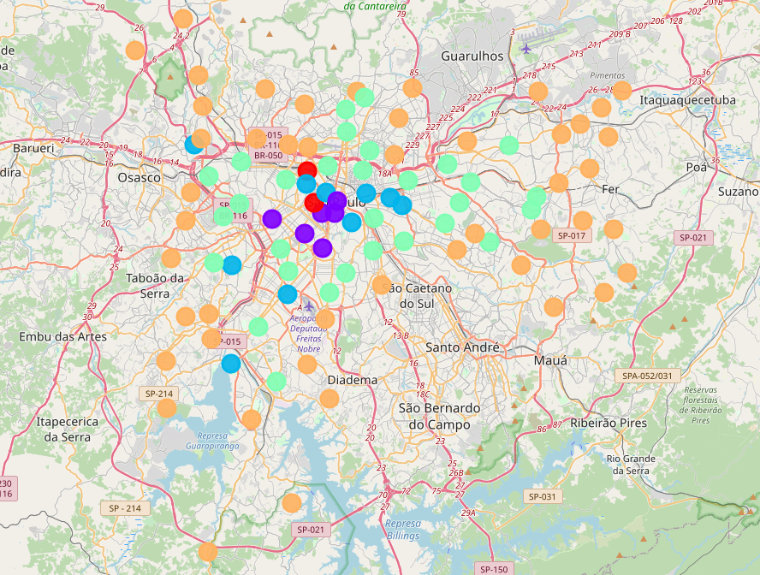
Modeling
K-mean algorism was used to cluster the districts in 5 categories based on social- economic indexes and school availability
by social-economics
by school avaibility
It showed that the districts near the financial center of the city is more wealthy and has better schools availability

Slide 7
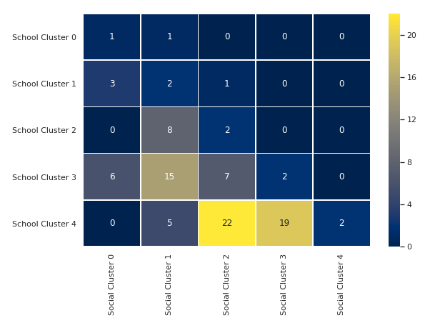
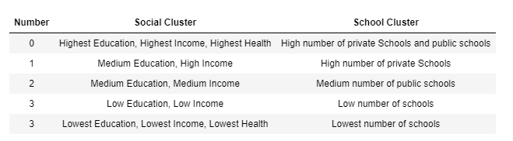
Correlation matrix
Legend
Most districts are on the lower spectrum of schools availability. 82% (78 out of 95) are on either cluster 4 or 3.
The districts on Social-economic cluster 0, 1 and 2 follow the diagonal line, where there is a correlation between both clusters

Slide 8
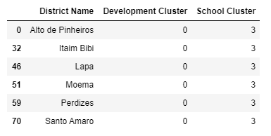
Correlation matrix
Exception
Those 6 affluent districts have potential for new private or public schools installation

Slide 9
conclusion
Clustering showed that the districts near the financial center of the city is more wealthy and has better schools availability
There is a great disparity in school availability between districts, where most districts situated on the lower 2 tiers.
More affluent district have more schools available, either public or private. There are 6 districts that are exception for this trend

